Slide 1
Power Harmonic Analyser using ADE7880 and KL-34 Processor
Manoj Gulati
SESDP-14
11/17/2014

Slide 2
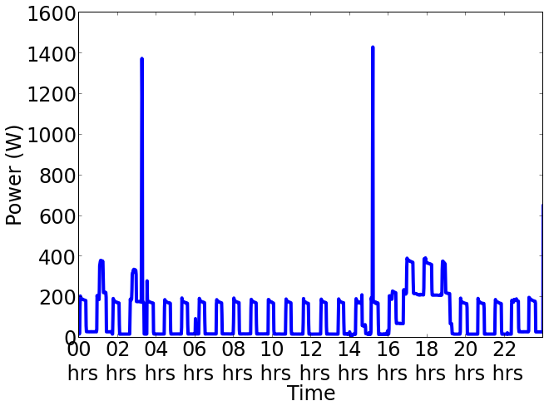
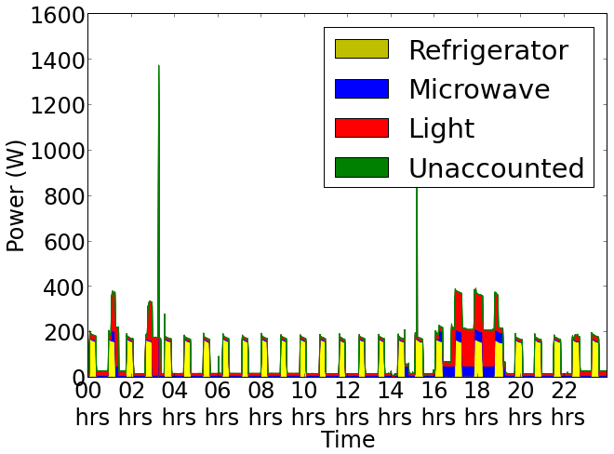
Non Intrusive Load Monitoring
Image Source- http://energy.iiitd.edu.in

Slide 3
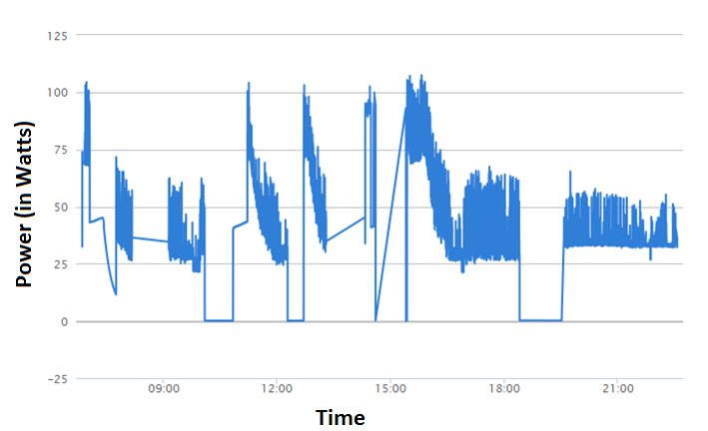
Challenges with Time Domain
Time varying power consumption [Barker, 2013]
100 W
Figure: Time varying power consumption of a laptop charger.
Image: Batra, 2013
Notes:
Why single point sensing is complex?
Answer to this question lies in this plot. As we know most of the time series modelling approaches are based on a assumption that appliances show time-invariant power consumption.
But in practice most of the present day appliances don’t follow this. Now question comes why ? I will try to answer this in coming slides.
Few more challenges include appliances with similar power signatures and low power appliances which get overlapped and make disaggregation a complex task.

Slide 4
100 W
Time varying power consumption of a laptop charger
Notes:
Why single point sensing is complex?
Answer to this question lies in this plot. As we know most of the time series modelling approaches are based on a assumption that appliances show time-invariant power consumption.
But in practice most of the present day appliances don’t follow this. Now question comes why ? I will try to answer this in coming slides.
Few more challenges include appliances with similar power signatures and low power appliances which get overlapped and make disaggregation a complex task.

Slide 5
Possible Solution
Frequency Domain analysis using power line harmonics.

Slide 6
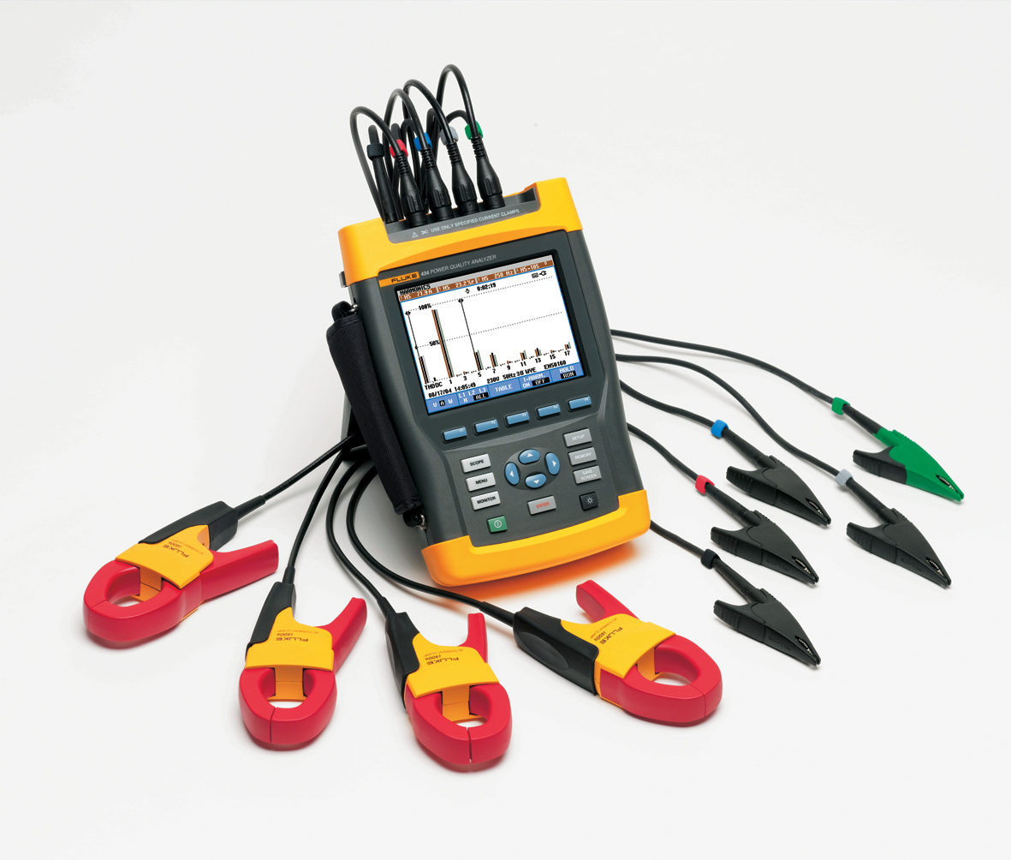
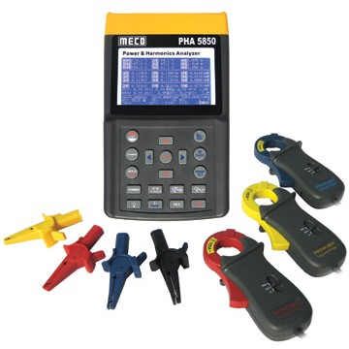
COTS
Challenges with COTS
Cost around 2 lakhs
Lack of configurability
Lack of communication interfaces

Slide 7
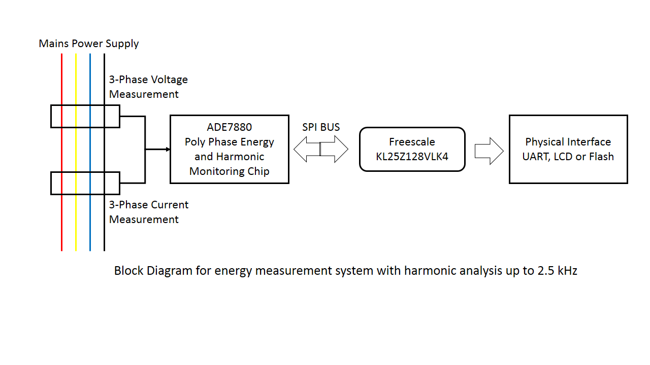
Harmonic Analyser
KL34

Slide 8
Any Progress??

Slide 9
Thank You
Manojg.

